Slide 1
DM2004 – Online Advertising and Analytics
Portfolio TSC: Search Engine Optimisation (RET-OTO-3005-1.1)
Learner Full Name according to NRIC: Learner NRIC / FIN No.:

Slide 2
Learning Unit 2: Goals and Performance Indicators

Slide 3
Unique Selling Point & Marketing Message
Product
Unique Selling Point
Marketing Message
SMART Goal

Slide 4
Learning Unit 3: Keyword Research

Slide 5
Use Google Trends to discover related search keywords. Screenshot the comparison trend data based on your products/services and paste here.
Portfolio Activity 3.1

Slide 6
Use Google Trends to discover related search keywords. Screenshot the trends.google.com – related queries and paste here.
Portfolio Activity 3.2

Slide 7
Use Keyword.io to discover related search keywords. Select at least 3 best keywords and then screenshot it and paste here.
Portfolio Activity 3.3

Slide 8
Portfolio Activity 3.4
[campaign name]
[Ad group name]
Ad Group
[Keyword #1]
[Keyword #2]
[Keyword #3]

Slide 9
Learning Unit 4: Google Search Ads

Slide 10
Screenshot your Google Ads – Dashboard and paste it here.
Portfolio Activity 4.1

Slide 11
Portfolio Activity 4.2
Screenshot the completed Campaign Setup Settings. Paste it here.

Slide 12
Portfolio Activity 4.3
Screenshot the completed Ad Group Setup Setting. Paste it here.

Slide 13
Portfolio Activity 4.4
Screenshot the completed Ad Created. Paste it here.

Slide 14
Portfolio Activity 4.5
View and Screenshot the Campaign Report Ad. Paste it here.

Slide 15
Learning Unit 5: Google Ads Tools

Slide 16
Portfolio Activity 5.1
Use the Keyword Planner to generate keyword ideas and bids. Screenshot the generated keyword ideas and bids and paste it here

Slide 17
Portfolio Activity 5.2
Insert the selected keywords into a campaign. Screenshot the selected keywords into a campaign and paste it here.

Slide 18
Portfolio Activity 5.3
Add negative 3 negative keywords into a campaign. Screenshot the negative keywords and paste it here.

Slide 19
Portfolio Activity 5.4
Setup a Split Test (A/B Test). Screenshot the Split Test (A/B Test) and paste it here.

Slide 20
Portfolio Activity 5.5
[campaign name]
[Ad group name]
Ad Group
Ad #1
Ad #2

Slide 21
Learning Unit 6: Measurement and Analytics

Slide 22
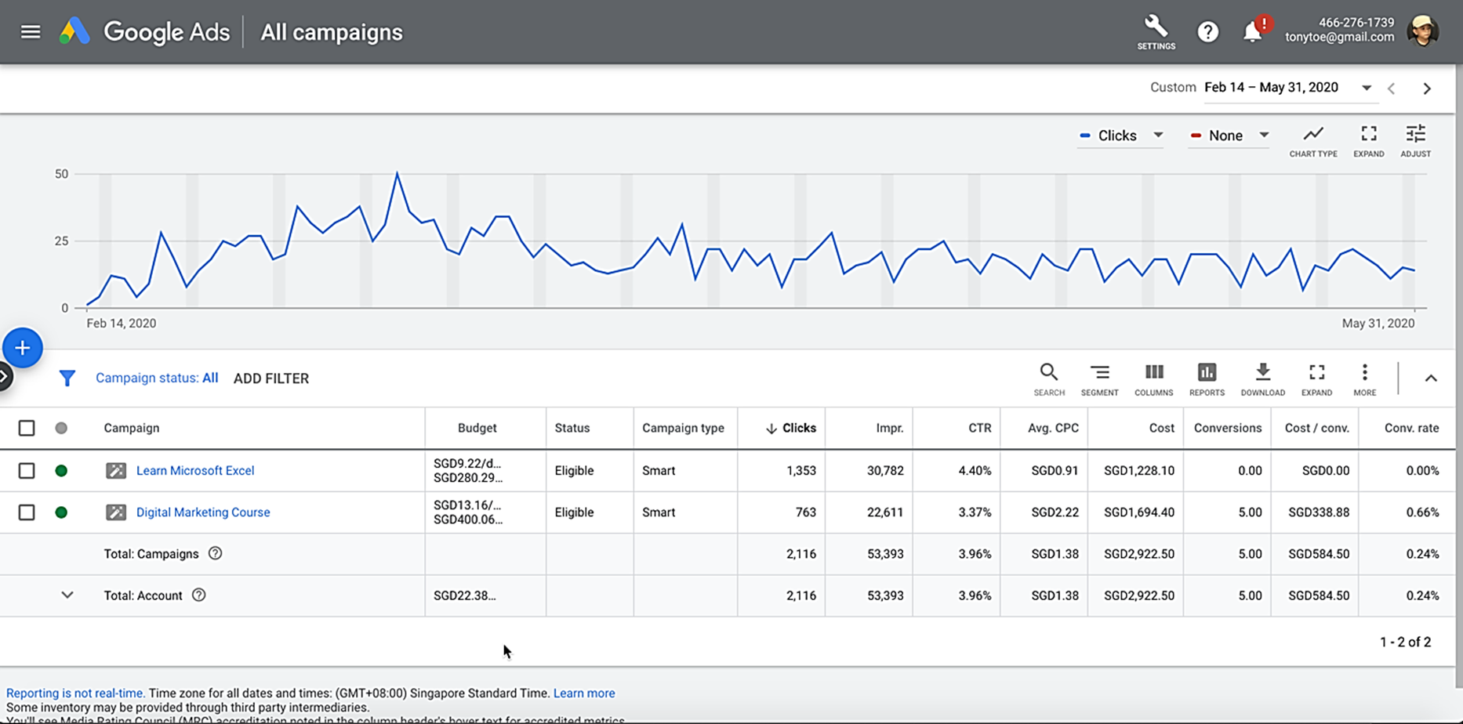
Google Ads – Data & Report

Slide 23
Portfolio Activity 6.1
Campaign
Period
Impression
Clicks
CTR
Avg. CPC
Cost Spent

Slide 24
Portfolio Activity 6.2
Write your Analysis here:

Slide 25
Learning Unit 7: Optimisation and Iteration

Slide 26
Portfolio Activity 7.1
[campaign name]
[Keyword #1]
[Keyword #2]
[Keyword #3]
[Keyword #1]
[Keyword #2]
[Keyword #3]
[Ad group name]
[Ad group name]
Ad #1
Ad #2
Ad #1
Ad #2

Slide 27
Portfolio Activity 7.2
Write your improvements here

Slide 28
Thank You

